Slide 1
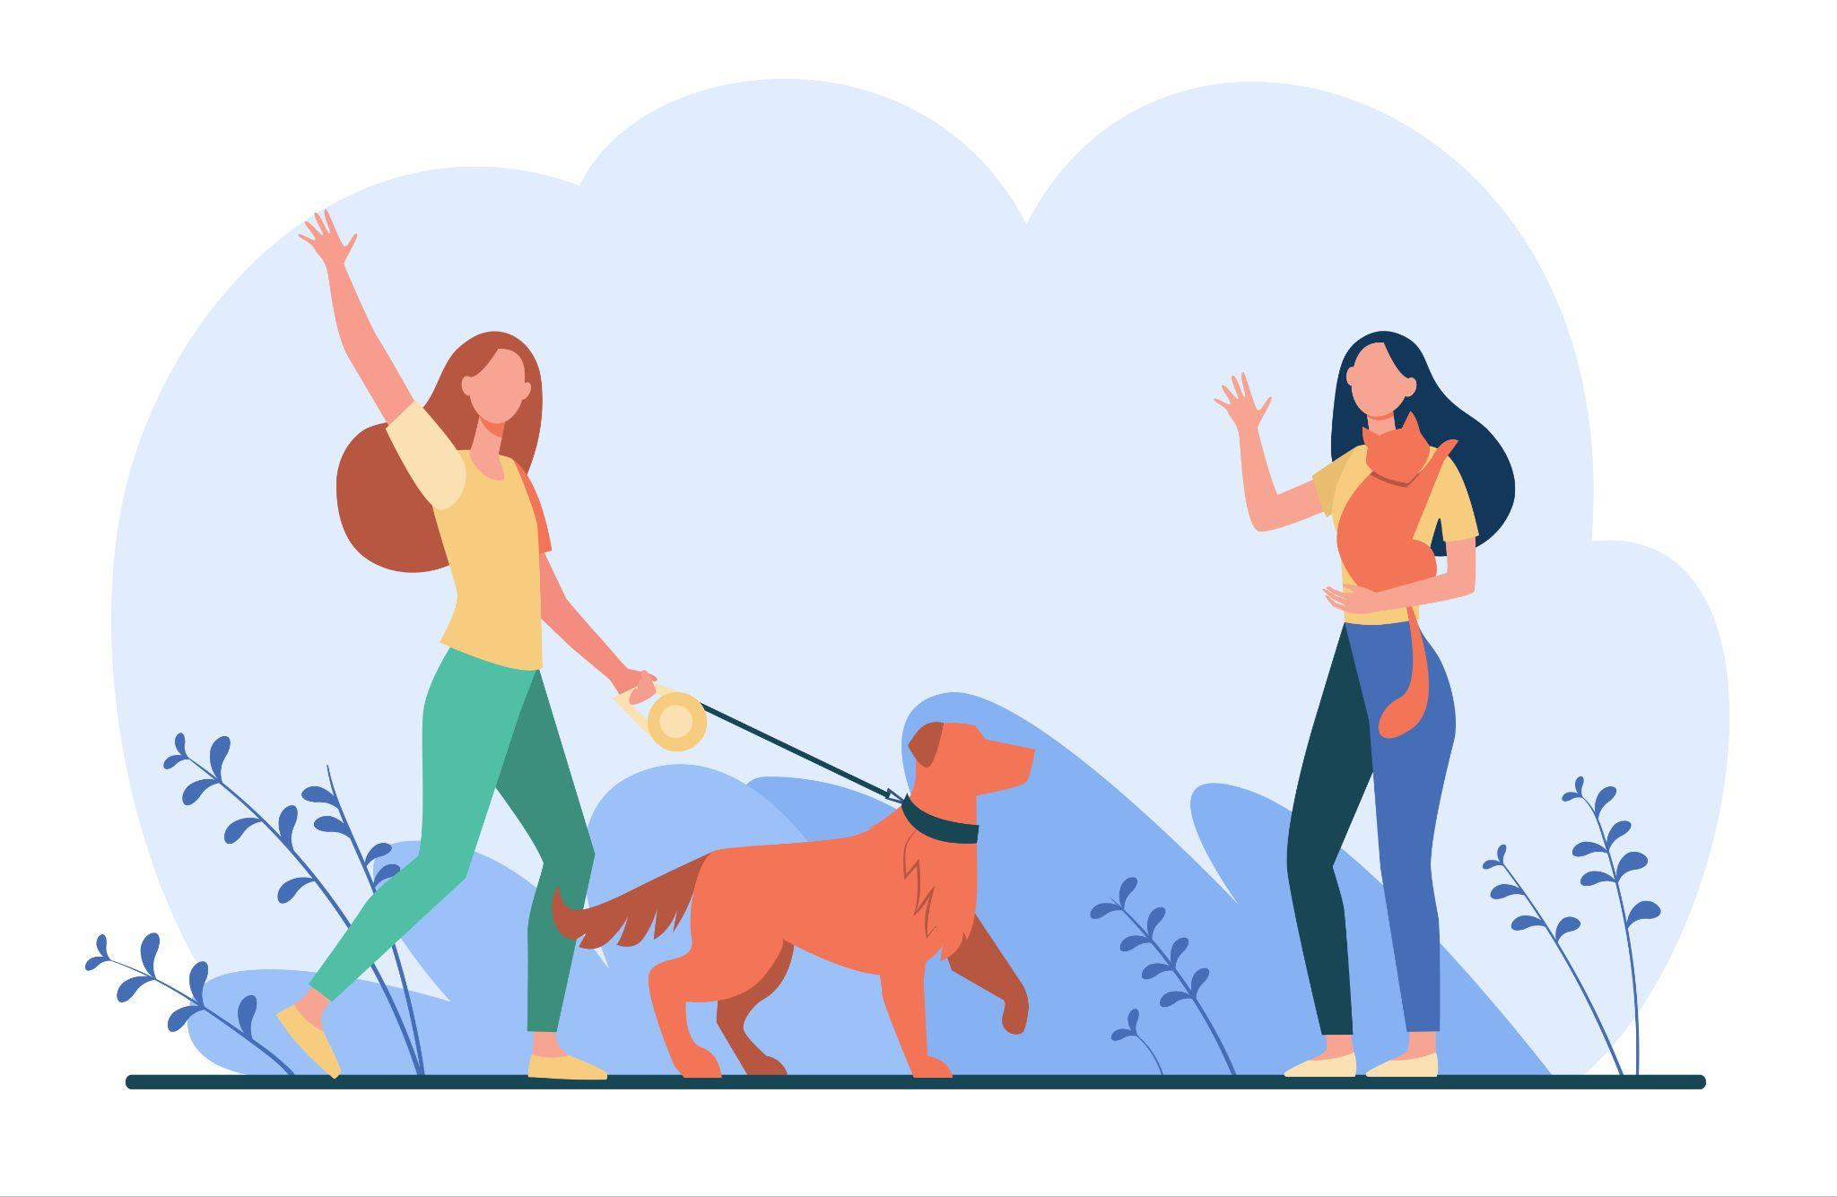
Elementary English A1

Slide 2
Hola colega!
Gracias por colaborar. Espero que este set de diapositivas te sirvan para comenzar tu camino como profesor/a freelance online.
Cada tema/contenido tiene al menos una actividad.
Siéntete libre de editar estas diapositivas como más te guste.
Lo ideal es que abras este documento en Google Slides, pues es su fuente original.
Let’s rock!

Slide 3

Greeting Phrases
Formal:
Good morning
How is everything?
Thanks for asking, everything is good.
Informal:
Hello! How are you?
Hi!
Hey hey!
I’m good/fine.
Not that good.
I’m just okay.
Slang:
What’s up?
How’s going?
S’all good man!
Same old, same old.
Hanging in there.

Slide 4
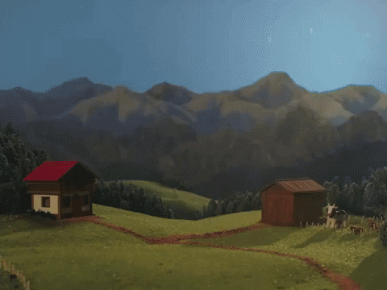

Time Phrases
The Past
The Present
The Future
Yesterday
Last week/month/weekend
An hour/week ago
Recently
This morning
Today
Now
Right now
Everyday
Every Monday, Tuesday..
In this moment
Tomorrow
Next week/month/year
In an hour/day/week
Eventually
It’s early
It’s late

Slide 5
My world
😄 YES You are a teacher. You drive a blue car. I always pet my cat. I’m always in class. | ☹️ NO You’re not a lawyer. I don’t teach French. I’m not Argentinian. | 🤔 Ask a question Are you a good journalist? Do you like going to the cinema? Yes, I am - No, I’m not. Yes, I do - No, I don’t
100% Always > Usually 80% > Sometimes 50% > Rarely 30% Occasionally 20% > Never 0%
Who are you? Make a mind map of ideas about you.

Slide 6
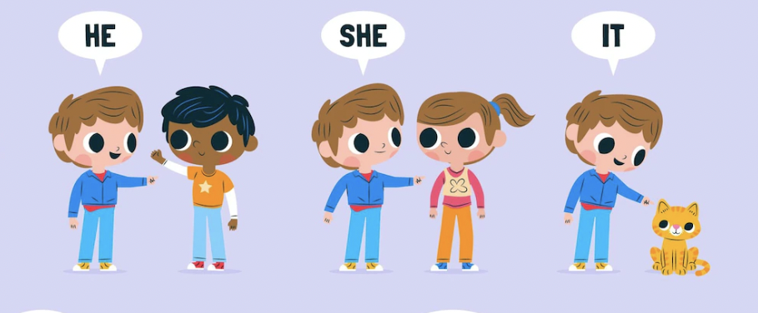
Their world is so big!
😄 YES She is a radiologist technician. He drives a blue car. | ☹️ NO He isn’t a journalist. She doesn’t teach French. She is not Argentinian. | 🤔 Ask a question Is she a good journalist? Does he like going to the cinema? Yes, she is - No, she isn’t. Yes, he does - No, he doesn’t
100% Always > Usually 80% > Sometimes 50% > Rarely 30% Occasionally 20% > Never 0%
Using pictures from next slide, ask questions about your best friend.
Notes:
https://www.teach-this.com/images/resources/run-and-write.pdf

Slide 7
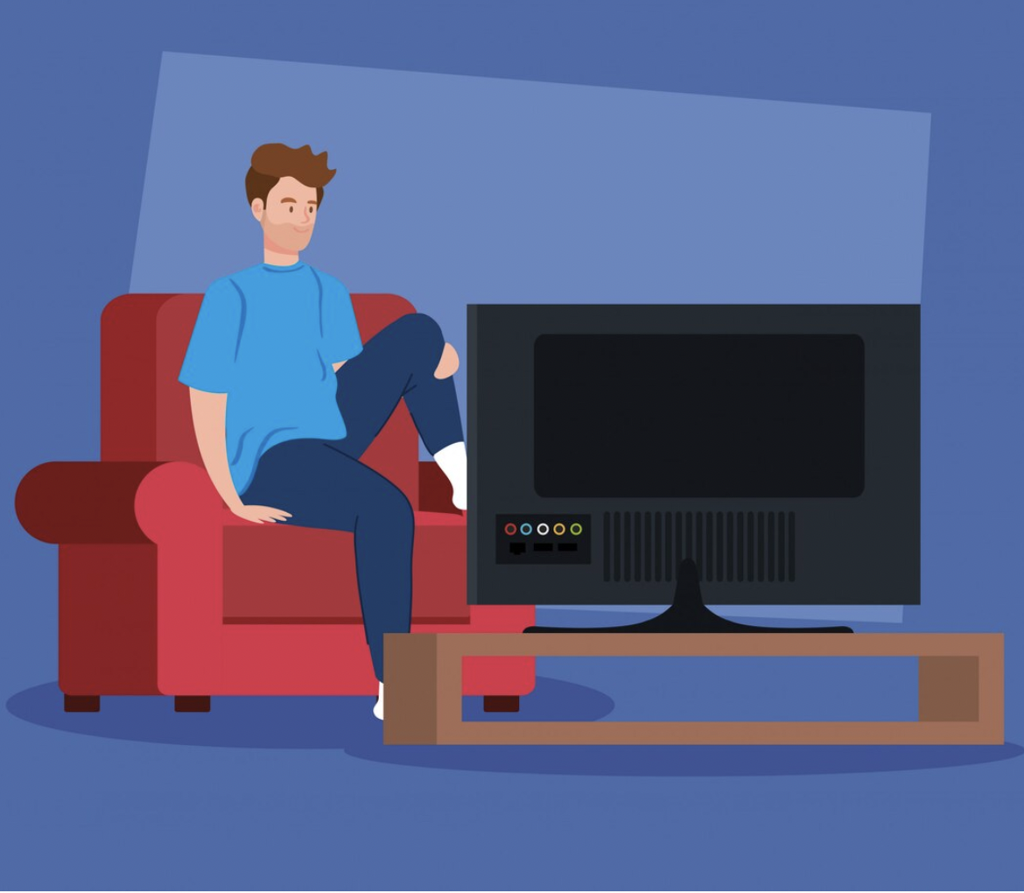
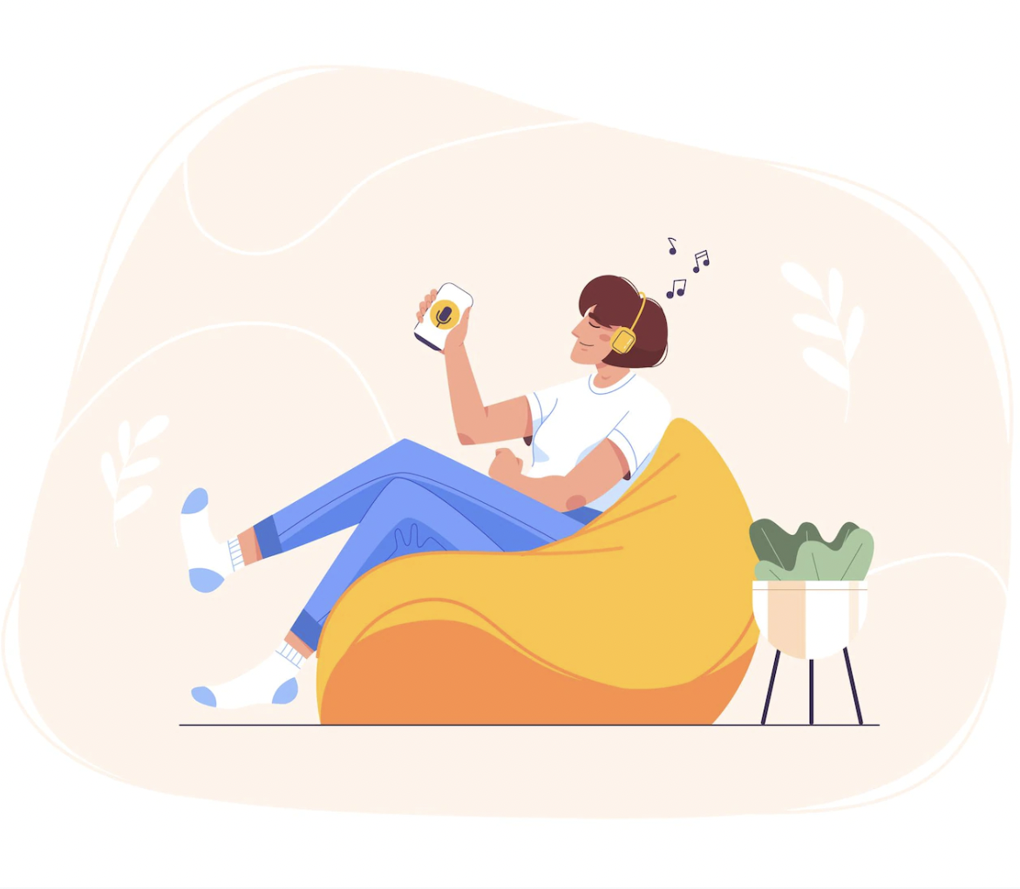
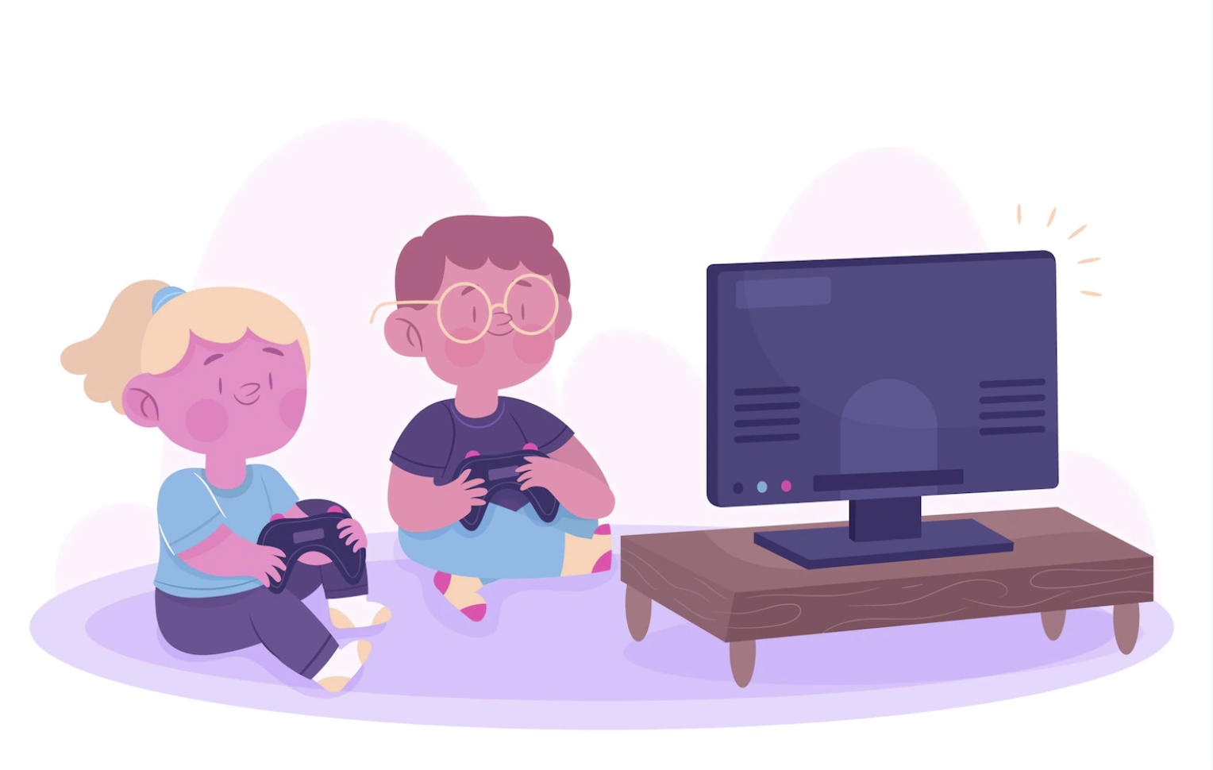
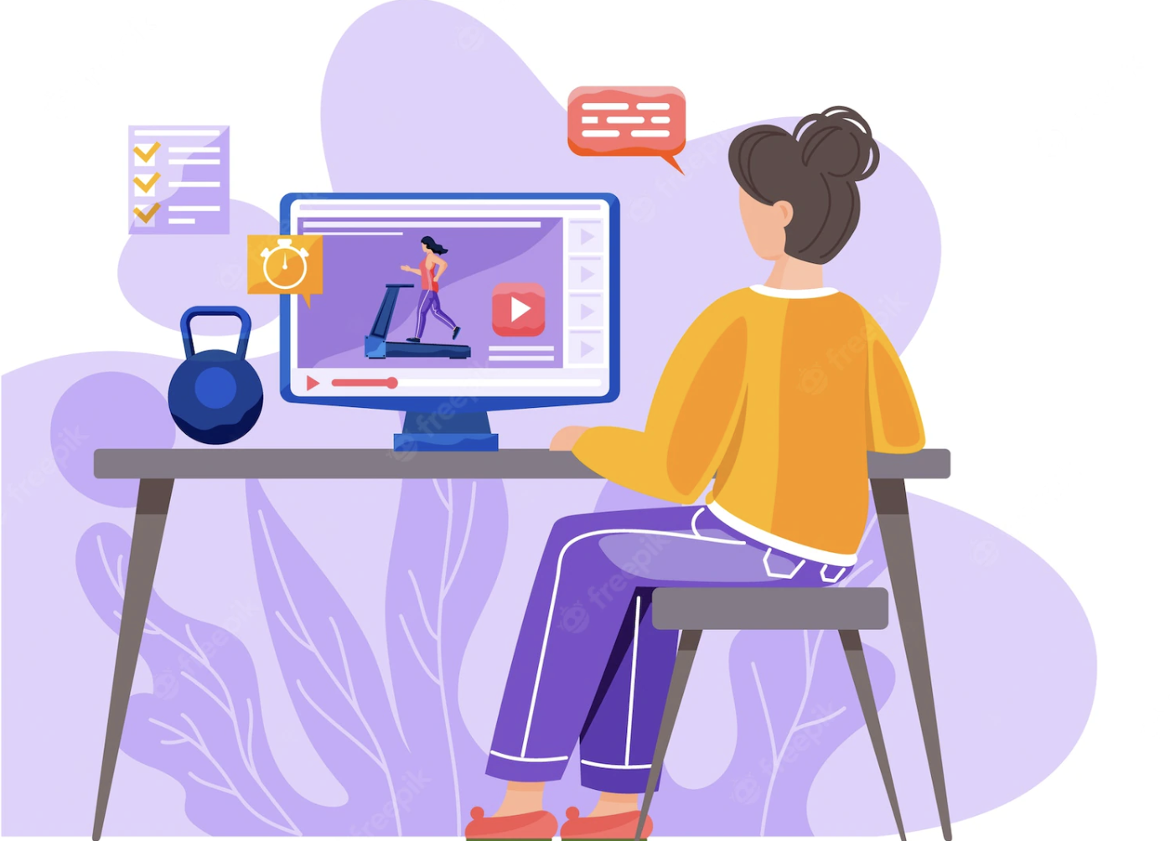
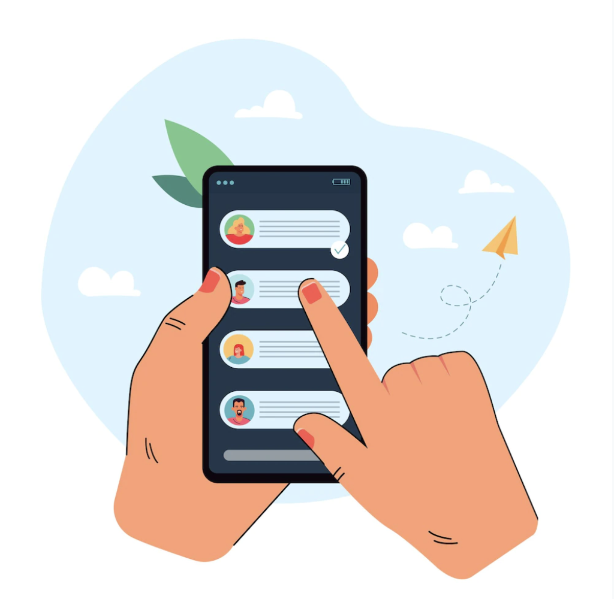

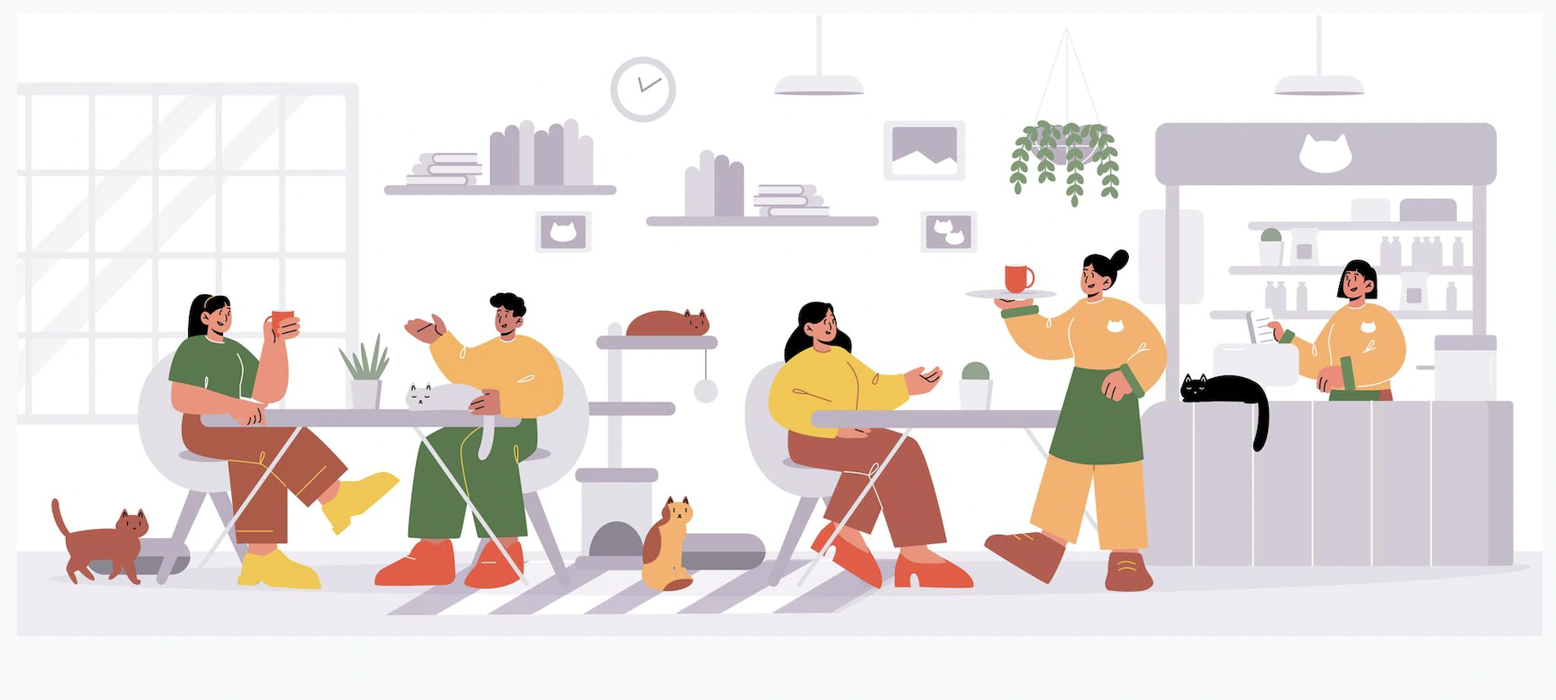
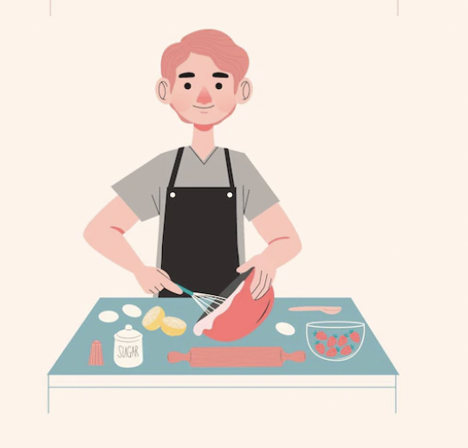
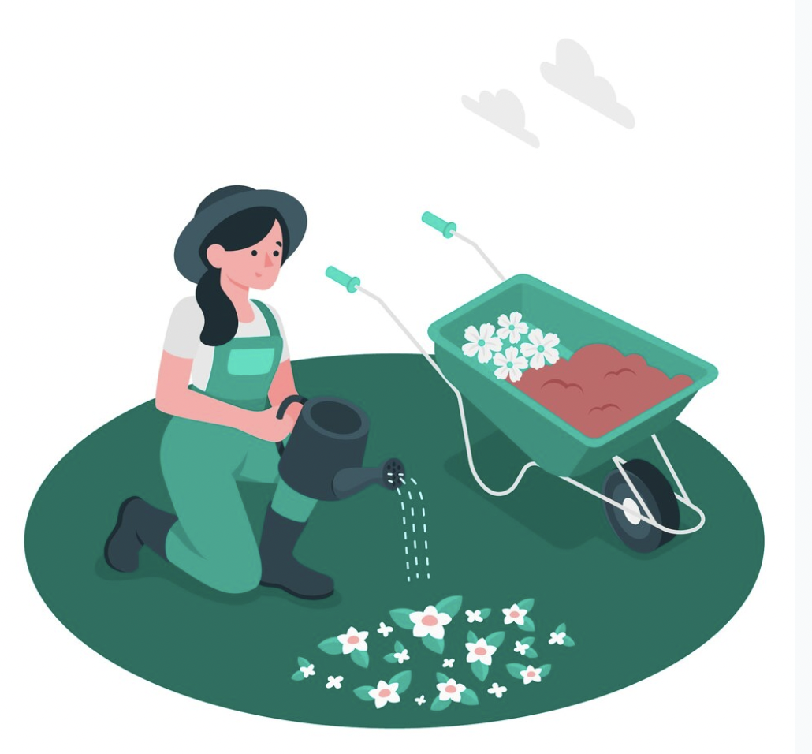
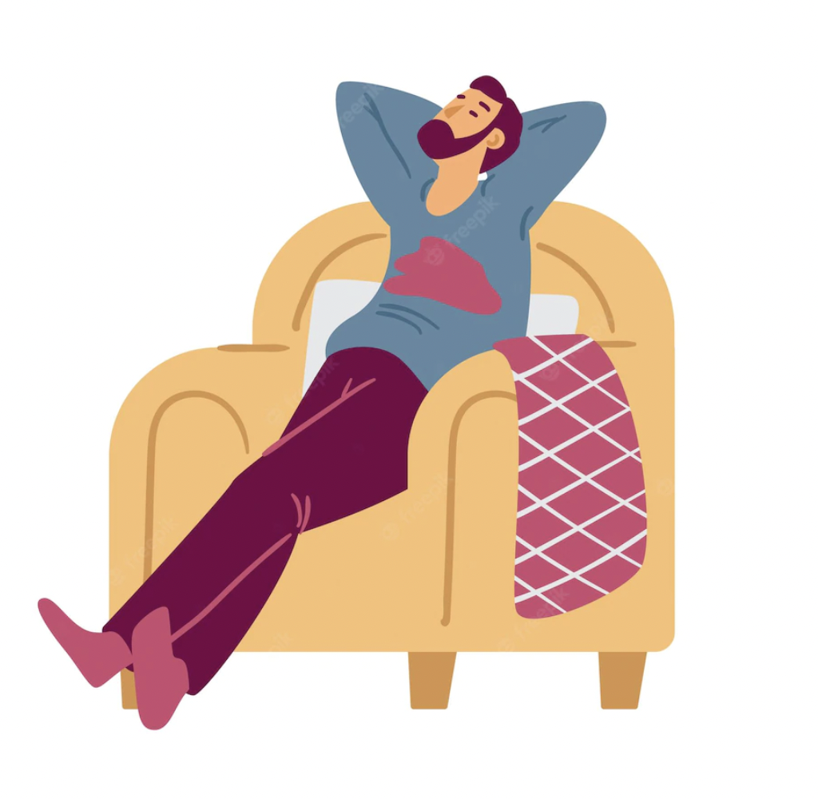
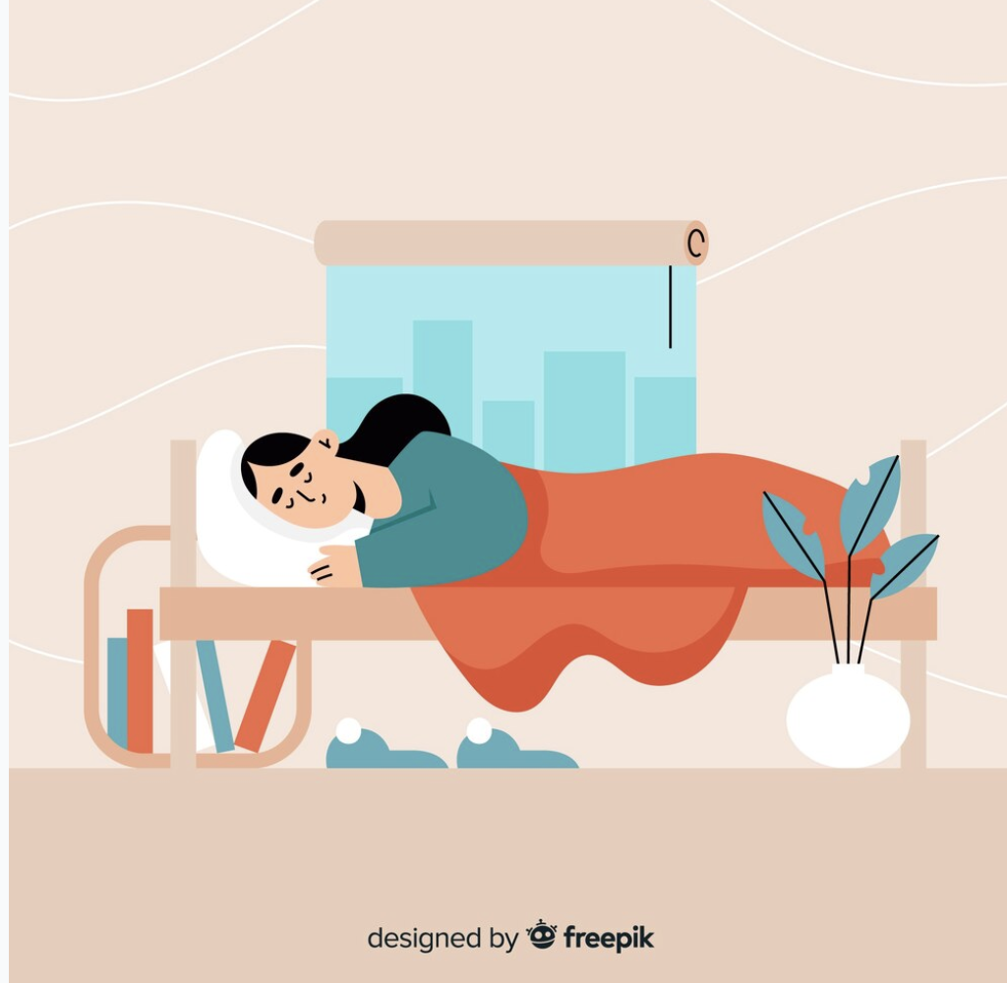

Slide 8
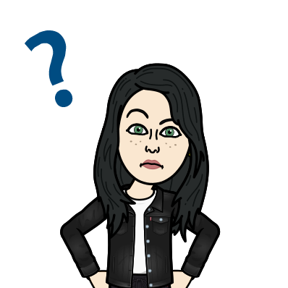
Let’s make questions
Icebreaker: A word, A question. I say a word, you ask a question and vice versa.
Closed >> Yes/No , So-so
Are you happy? Yes, I am.
Do you like pizza?
Do you have many friends?
Does she like bananas?
Can you..play the piano? Yes, I can/ No, I can’t
Would you play a game with me?
Open > Specific Information
What do you like to do/doing?/what time?/what is?
Where do you play games? Where is your brother?
When do you play games? When is your meeting?
Why do you play games? Why is your pet so cute?
Who do you play games with? Who is your son?
Whose shoes are those? (De quién?)
How often? How long? How many? How much?
Yes, I do - No, I don’t.
Yes, I am - No, I’m not.
Yes, I did - No, I didn’t.

Slide 9
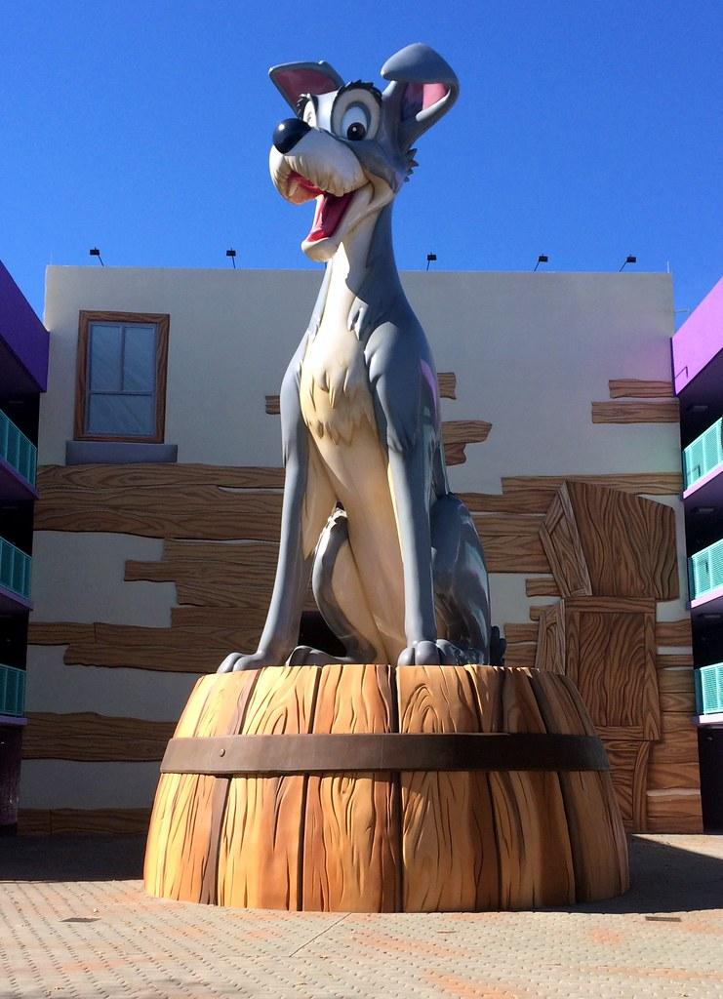

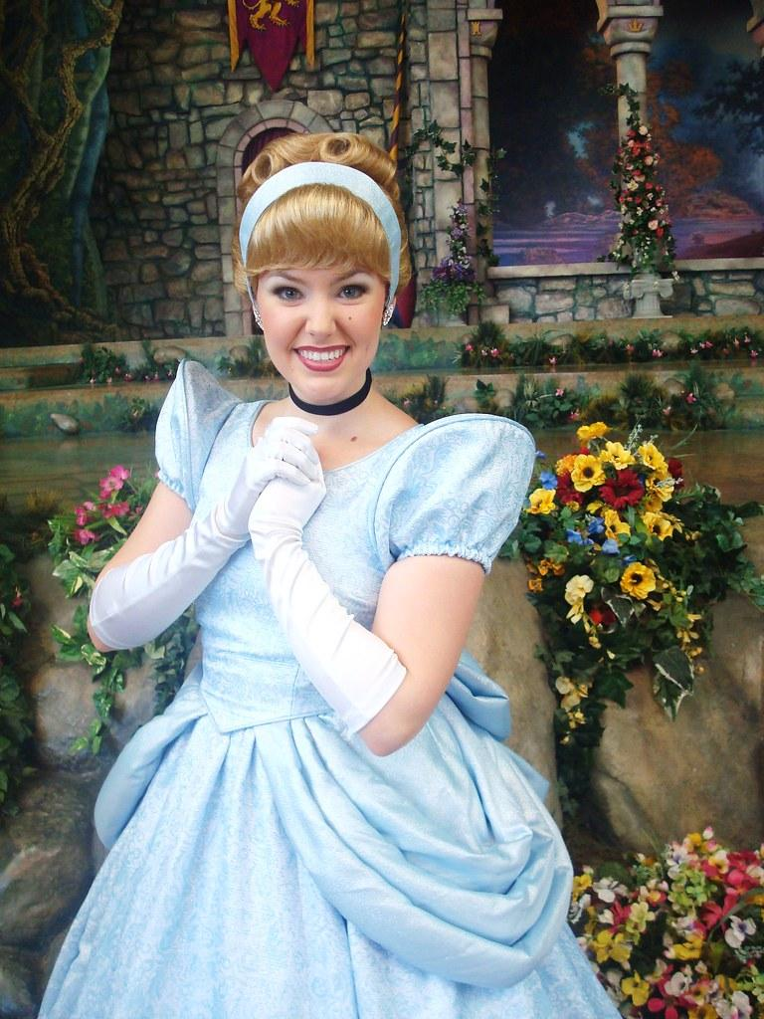
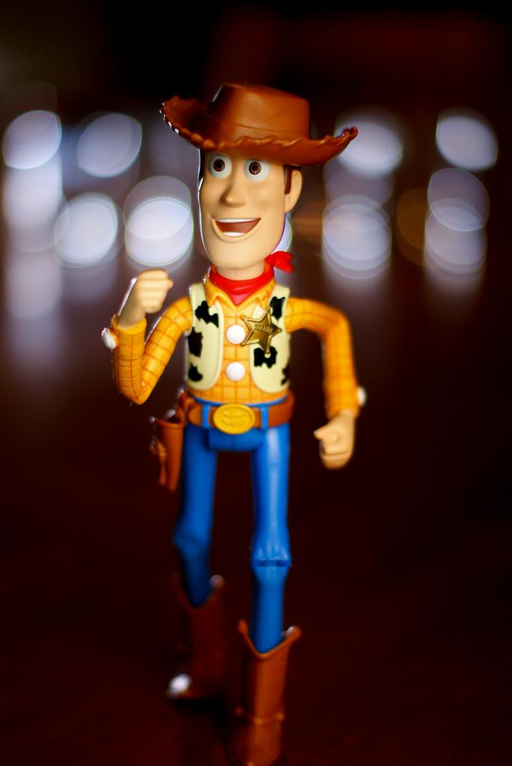
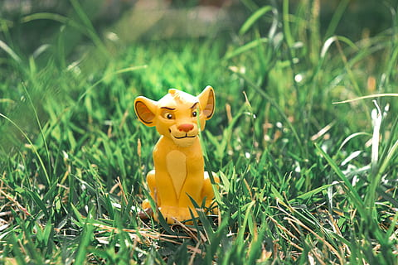
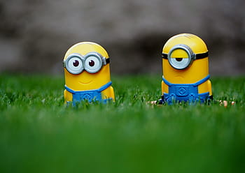
A yes and a no
Think and write a sentence about these celebrities. Read it aloud. Ask a question to guess the secret celebrity.
Ariel
Cinderella
Golfo
Woody
Simba
Minions

Slide 10

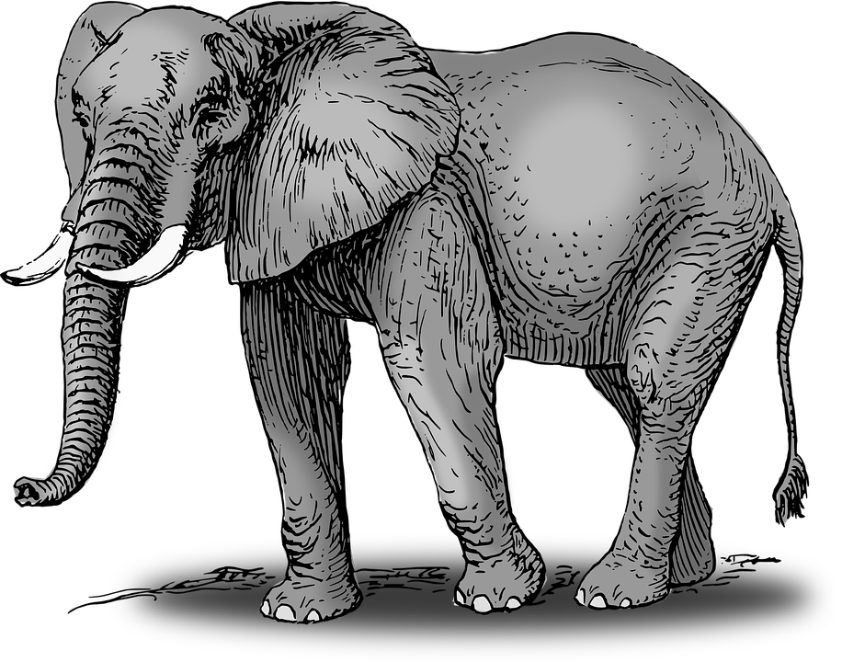

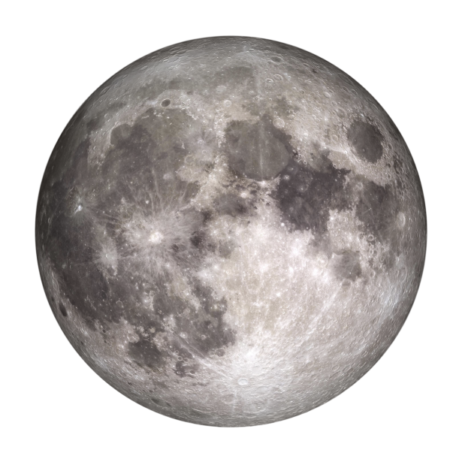
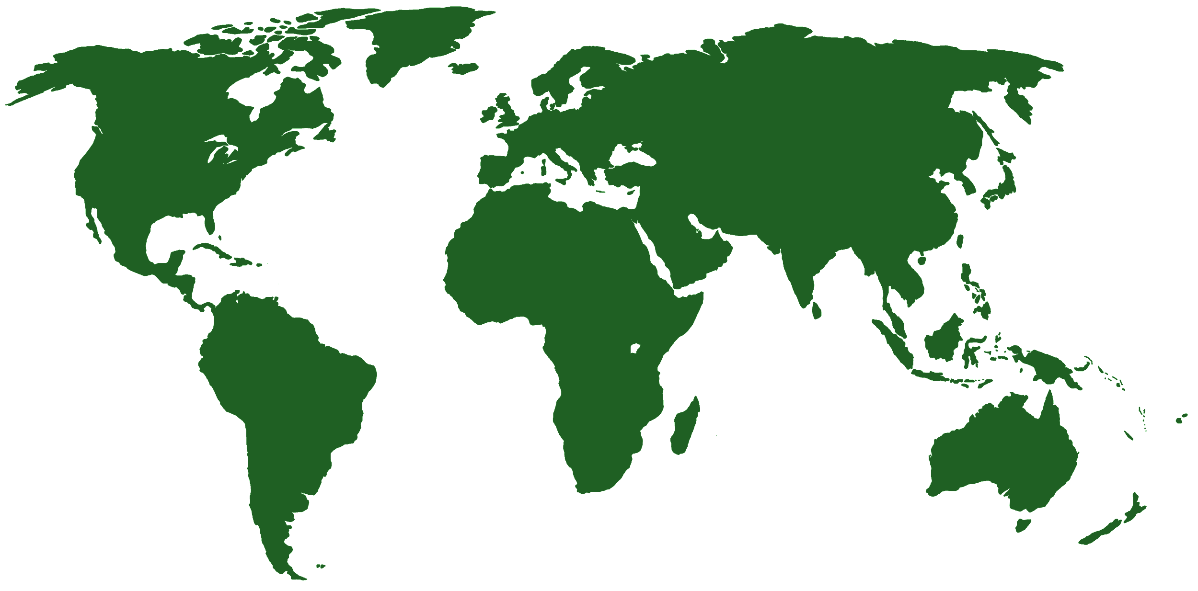
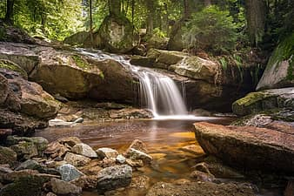
Definite and Indefinite Articles
💡 Warm up: ABC Memory Game. Say accessories or objects using the letters of the alphabet.
A: Next word has a consonant sound. Use it when naming things for the first time or are part of a group. | AN: Next word has a vowel sound. *plural: some | The. Use it when the listener already knows which thing we are talking about because it was mentioned before or because there's only one of them. | No article. Things in general, countries without the word ‘united’ in their names. Plural exclamations.

Slide 11
Prepositions of Place and Time
Time
Place
IN: XXI, May, 1996, seasons, in the morning, in the afternoon, in the evening. (6pm - 9pm)
In
On
At
IN: In Asia, In Chile, In O’higgins state, in Santiago, in Saturn. In enclosed spaces and limited areas.
ON: 28th May, on Monday, on Saturday, etc.(days of the week) On Monday morning, Special days: my b-day, New Year’s Day
ON: Pio Nono Street, on Chiloe Island, Alameda Avenue, Diagon Alley. *Transportation: train, plane. Lines: the coast, the path. Surfaces
AT: at 5pm, at this hour, at this moment at noon, at night, at midnight, at/on the weekend. Festivals: Christmas, Easter.
AT: Pio Nono Street 4831, Santiago. /At John Doe intersection / Buildings. With a point: at the bus stop
Notes:
https://www.teach-this.com/images/resources/place-prepositions-interactive-worksheet-teachers-notes.pdf

Slide 12
Time and Place Questionnaire
Where do you live?
When is your birthday?
When do you study English?
Do you know any famous person whose birthday is the same as you?
How do you commute to work?

Slide 13
Possessive Adjectives
Possessive Adjectives | I like cats….My cat is nice. You have one daughter….Your daughter is smart. She reads books…. Her book is big He wears pants…. His green pants are small. The robot has a computer….Its computer is red. We are in class now…..Our class is very important. They have three dogs in his house….Their dogs are beautiful.
Possessive ‘s | This jacket is Orietta’s. /That’s Orietta’s jacket.
It must be true! Drag the words and say sentences.
Notes:
Homework https://www.allthingsgrammar.com/uploads/2/3/2/9/23290220/atg-worksheet-posspronouns.pdf

Slide 14
Imperatives + let’s
Icebreaker: Listen and make invitations: Teacher: I’m bored. You: let’s…!
Imperatives are a type of sentence. Use to give indications, orders, state rules, prohibitions. They are special because you don’t need the word ‘you’. It’s implicit.
EXAMPLES: Come over here! , Don’t do that!, Wait for me! Turn left and go straight. , … Make a cup of coffee please, Don’t touch me, Close the door, Sit down, etc.
Think and write two rules/instructions you have to follow in these places/situations.
Rules at school/hospital
Directions on how to go from A to B in the city
Preparing a sandwich
Rules for children
Who said this?

Slide 15
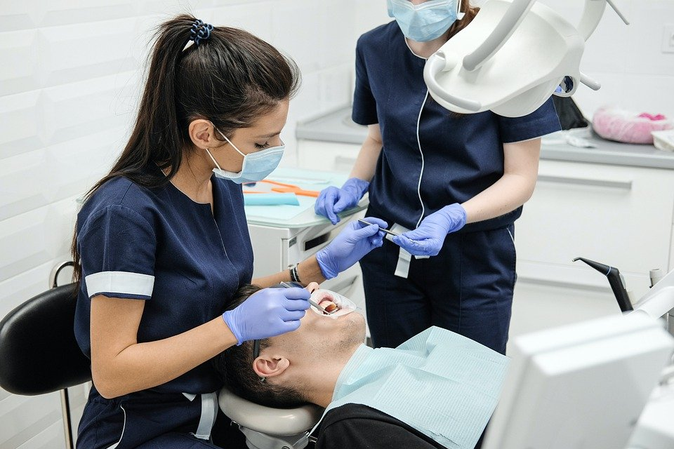
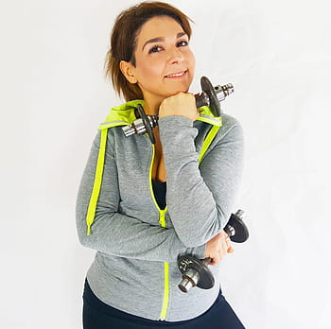

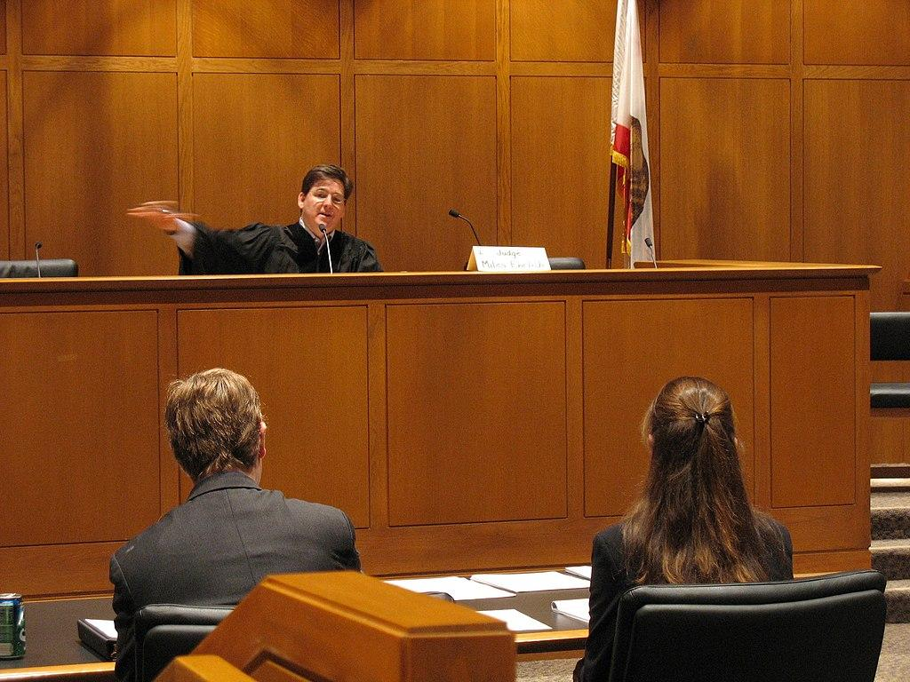
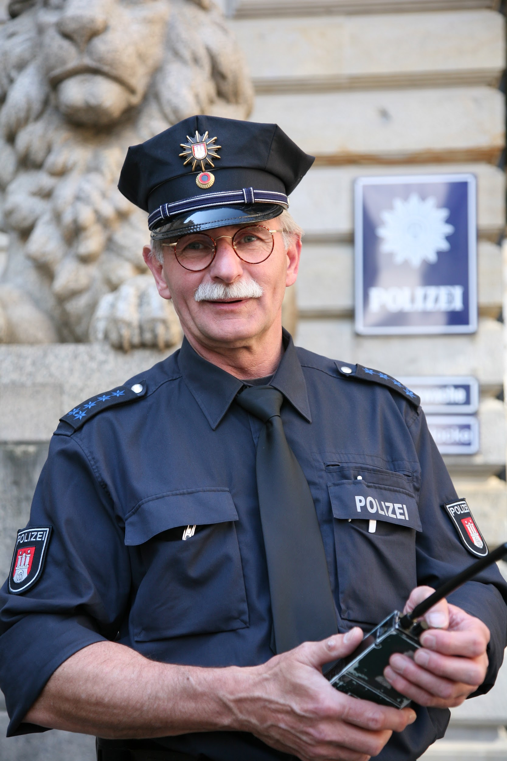

Run faster!
Stop now!
Shhh! Be silent!
Ask a question!
Put away those books.
Open your mouth, please.
Brush your teeth more often.
Jury, state your verdict.
Show me your ID
Push harder!
Juanito, quiet please.
Attorney, state your case.

Slide 16
I can speak English, but I can’t run a marathon.
Warm up: What unusual things can you do…?
Affirmative | Negative | Interrogative
I can run in the park. She can speak three languages. They can open the doors. I can do the dishes. | I can’t run in the park. She can’t speak French. We cannot accept this insults. | Can you run in the park? Yes, I can/No, I can’t Can she speak English? Yes, she can/No, she can’t Can they…? Can we…?
Ability Bingo!

Slide 17
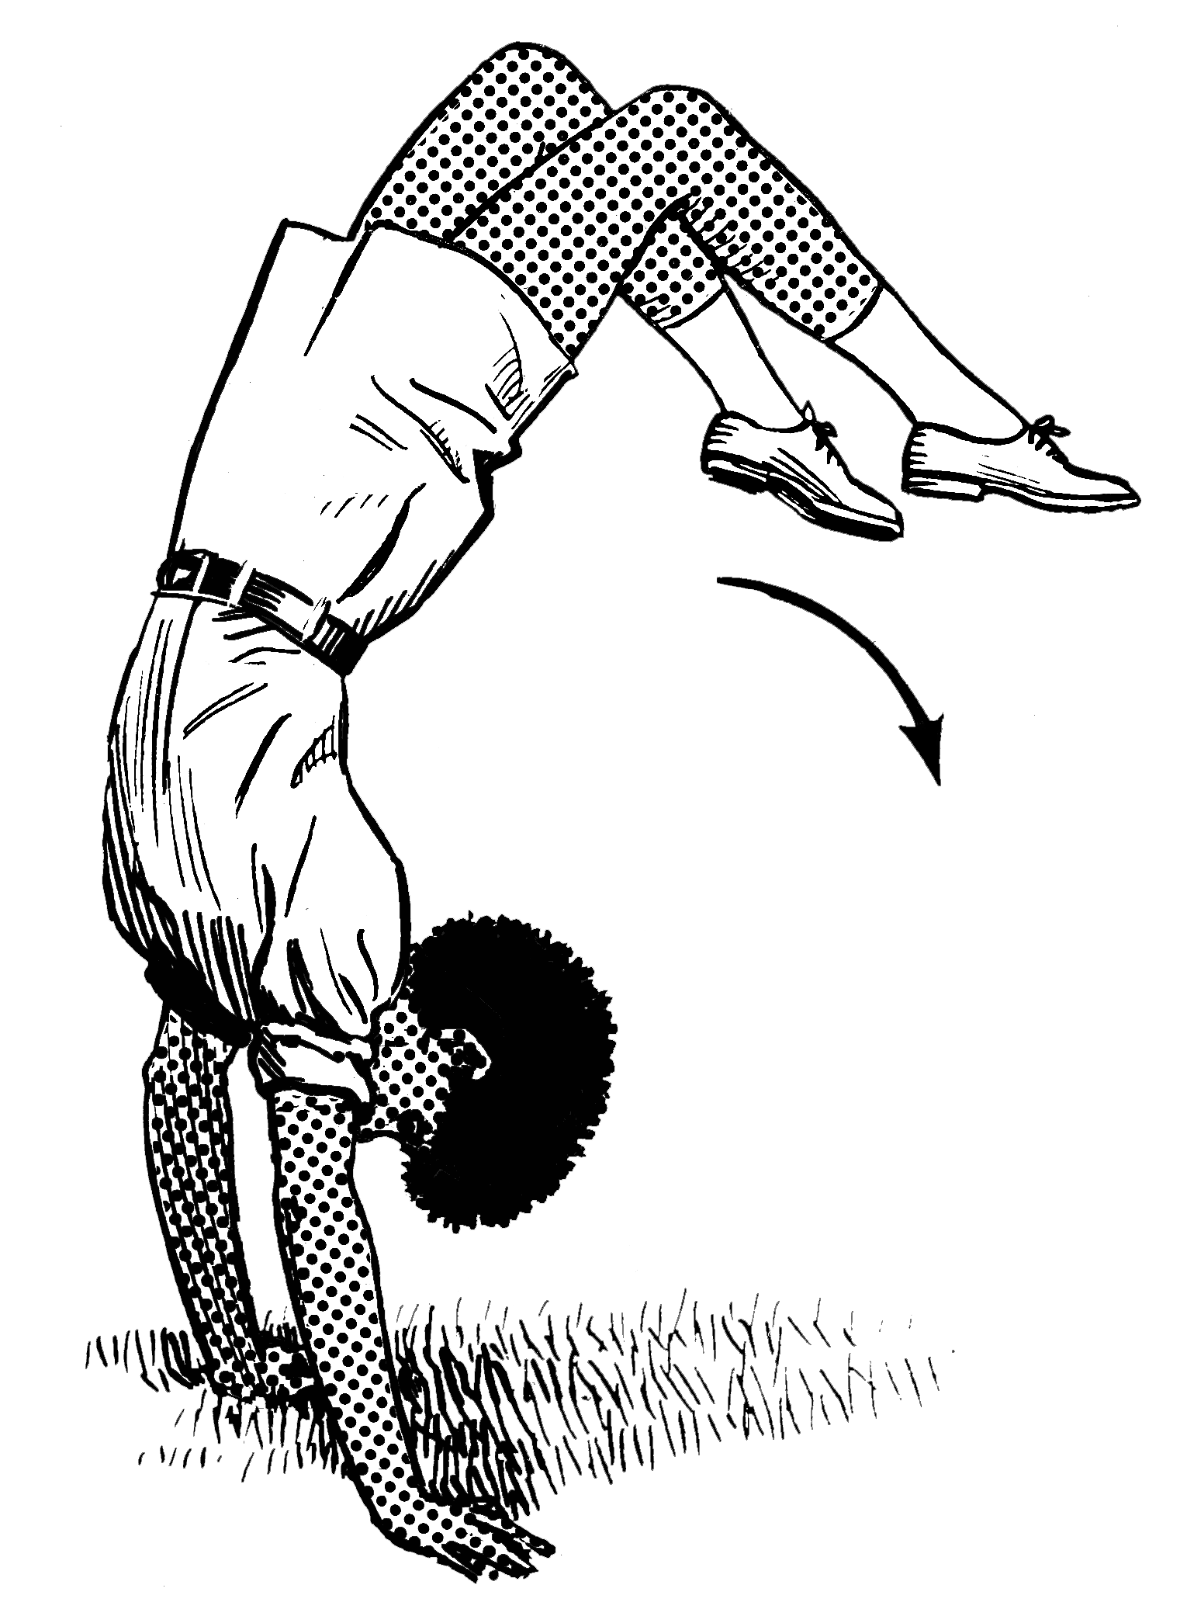
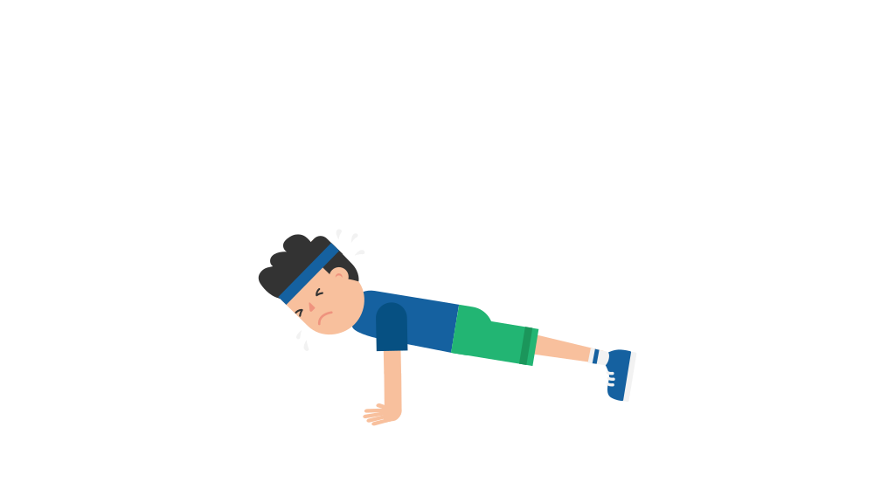
Ability Bingo
Ask questions using ‘Can you…?’. Change the color of the blocks to mark the prompts that were used.
Can wiggle their ears | Can name ten colors | Can raise one eyebrow | Can whistle happy b-day song | Can name 3 countries in Africa
Can draw an elephant | Can wink with left and right eye | Can name 3 countries in South America | Can write a word with their left hand | Can roll their tongue
Can say “red lorry, yellow lorry” five times very fast | Can name 10 capital cities | Can make an origami bird | Can do a handstand | Can do 20 push ups
Can snap their fingers | Can bark like a dog | Can cross their eyes | Can dance | Can say the alphabet backwards
Can spell their pet’s name | Can hold their breath for 20 seconds | Can hop backwards with one foot | Can say “hello” in five languages | Can count backwards from 30

Slide 18
Small talk: hey, what’s up?
Small talk
Who makes small talk? | People who don’t know each other, and people who are acquaintances, people who is catching up.
What do people talk about? | Safe topics: weather, sports, food, work, travel, hobbies, films, current events, the news, etc.
Why do people make small talk? | To break the ice, to fill time, to get to know someone.
Phrases in your pocket
Cool!
That’s nice.
Wow, interesting.
Oh look at that!
Sweet! Fantastic!
Really? So sorry.
Oh, I didn’t know that.
Oh, what a pity.
Yeah, that sucks.
Activity: Choose a safe topic and let’s find things in common.
When we find one, ask a follow up question.

Slide 19
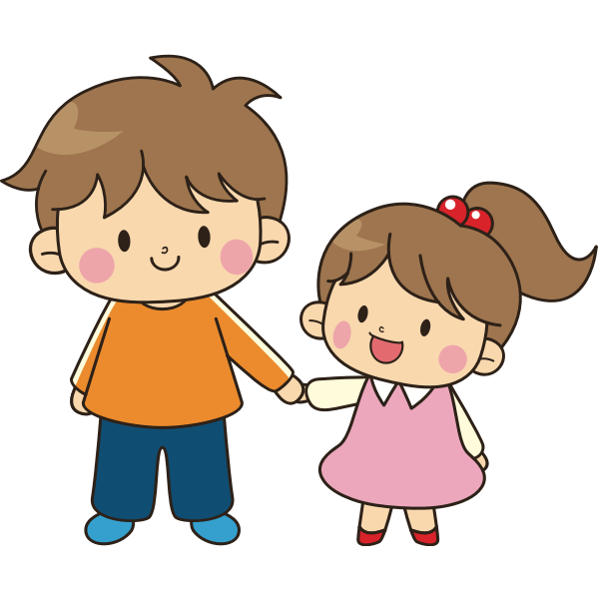
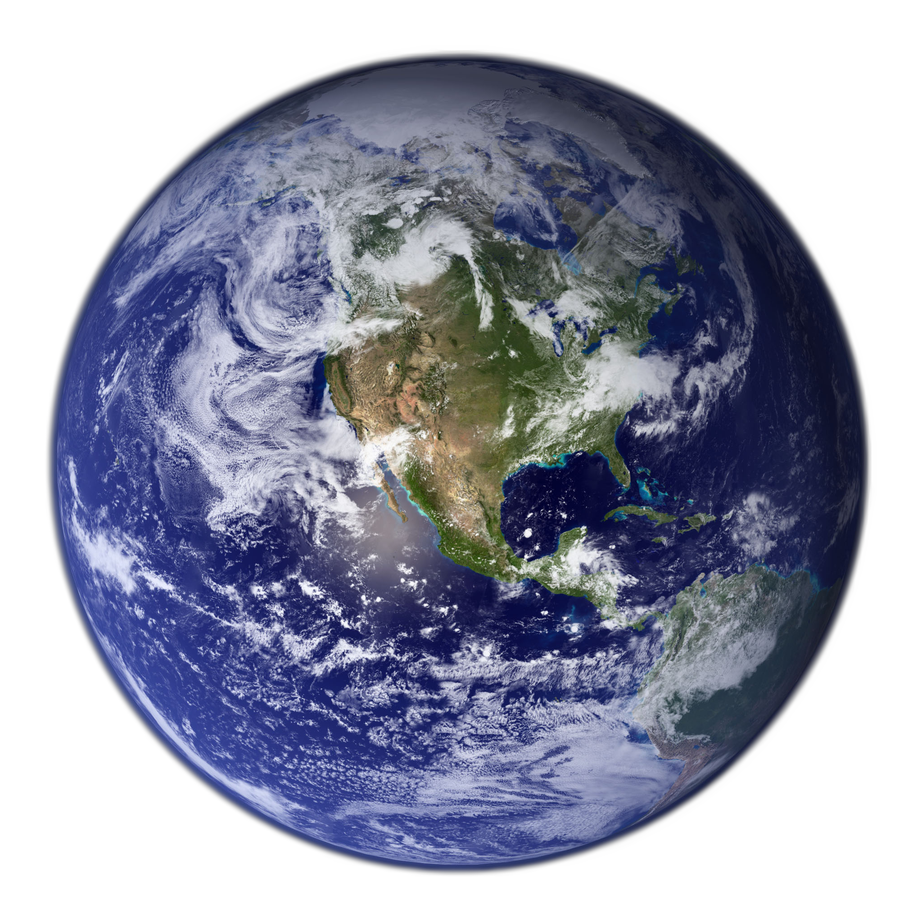
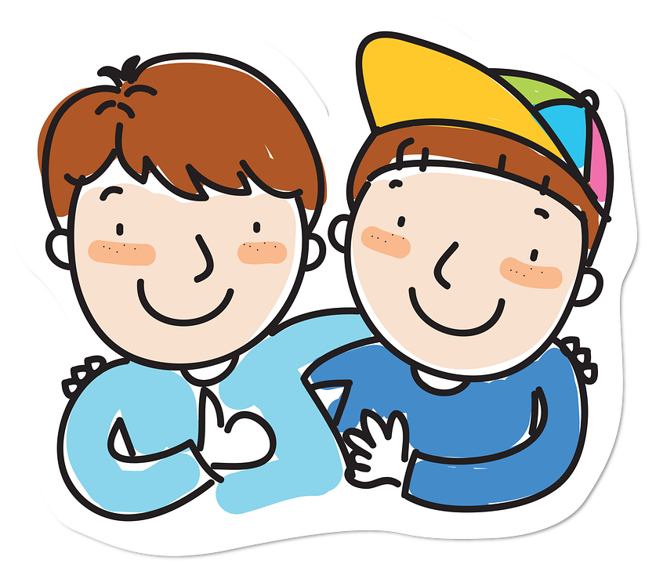

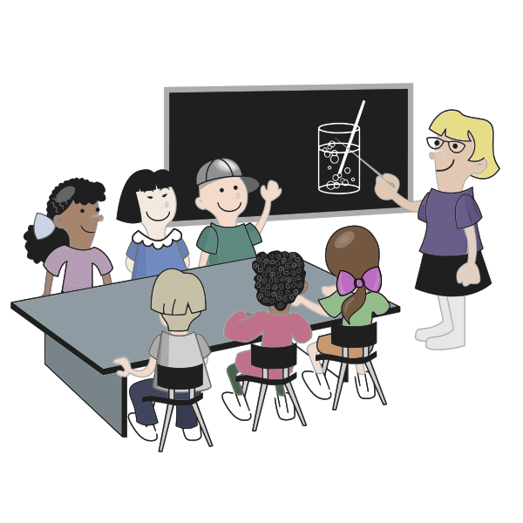
Comparatives and Superlatives
SUPERLATIVE adjectives are used to describe an object which is at the upper or lower limit of a quality (the "most" or "least" )
My friend Panchito is the oldest sibling in his family. My friend Panchito is the most/least interesting person in our class.
Short Adjectives: is the adj+est/iest of/in/among Long Adjectives: is the most/least adj of all times/ in my family / among my friends/ In the planet / in the galaxy
COMPARATIVE adjectives are used to compare differences between the two objects they describe.
My brother is taller than me. My sister is more/less intelligent than me.
Take out the ‘y’ Happy, easy, lazy, noisy, pretty > is happier than.

Slide 20
Superlative Packs!
Compare these elements. First, compare two (Comparative), then
Compare one with two others. (Superlative)
McDonalds
KFC
Starbucks
Bicycles
Cars
Trains
Parents
Students
Teachers
Books
Ipads
Magazines
Africa
Asia
Europe

Slide 21
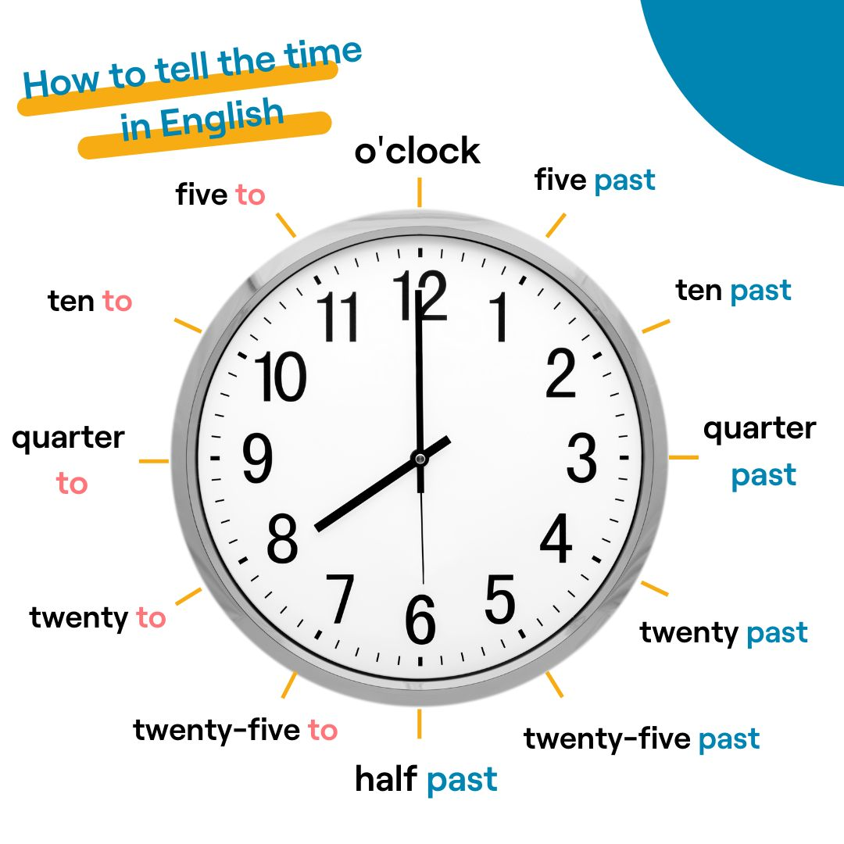
Telling the date and time
Warm up: What’s your favorite moment of the day? And date of the year?
🇬🇧
Written English | Spoken English | Numbers
🇺🇸 March 7 🇬🇧 7th March | March seventh The seventh of March | 3/7/17 7/3/17
Days
Use ordinal numbers:
1st = first
2nd = second
3rd = third
4th = fourth
5th = fifth
6th = sixth
7th = seventh
8th = eighth
9th = ninth
10th = tenth
Months
Write them with capital letters:
🚫august
✅August
Years:
Divide them into two parts
1984
Nineteen eighty four
*Exception: from 2000 to 2010 say two thousand and + number

Slide 22
Countables and Uncountables
Warm up: Make a shopping list.
There is…(singular) There isn’t any… Is there any gluten free baguettes? | …a potato, some milk, some ham, butter, jam. …potatoes, milk. … carrots? milk?
There are….(plural) There aren’t any… Are there some…? | … some apples. … onions. … beroots?
What’s in your fridge? Take a picture of what’s inside your fridge. Let’s ask questions: Is there any box of milk in your fridge? Yes, there is/No, there isn’t.

Slide 23

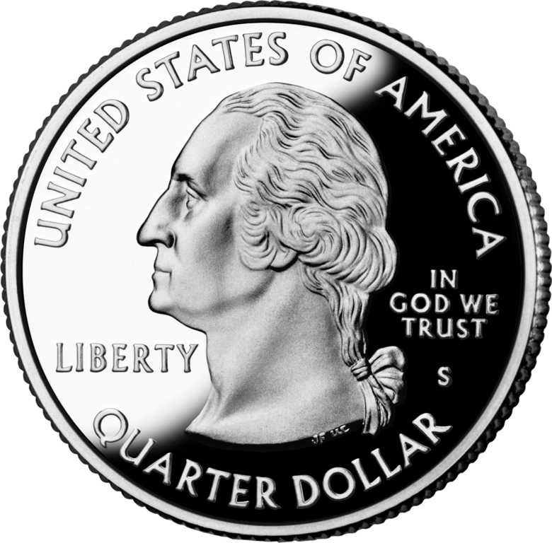
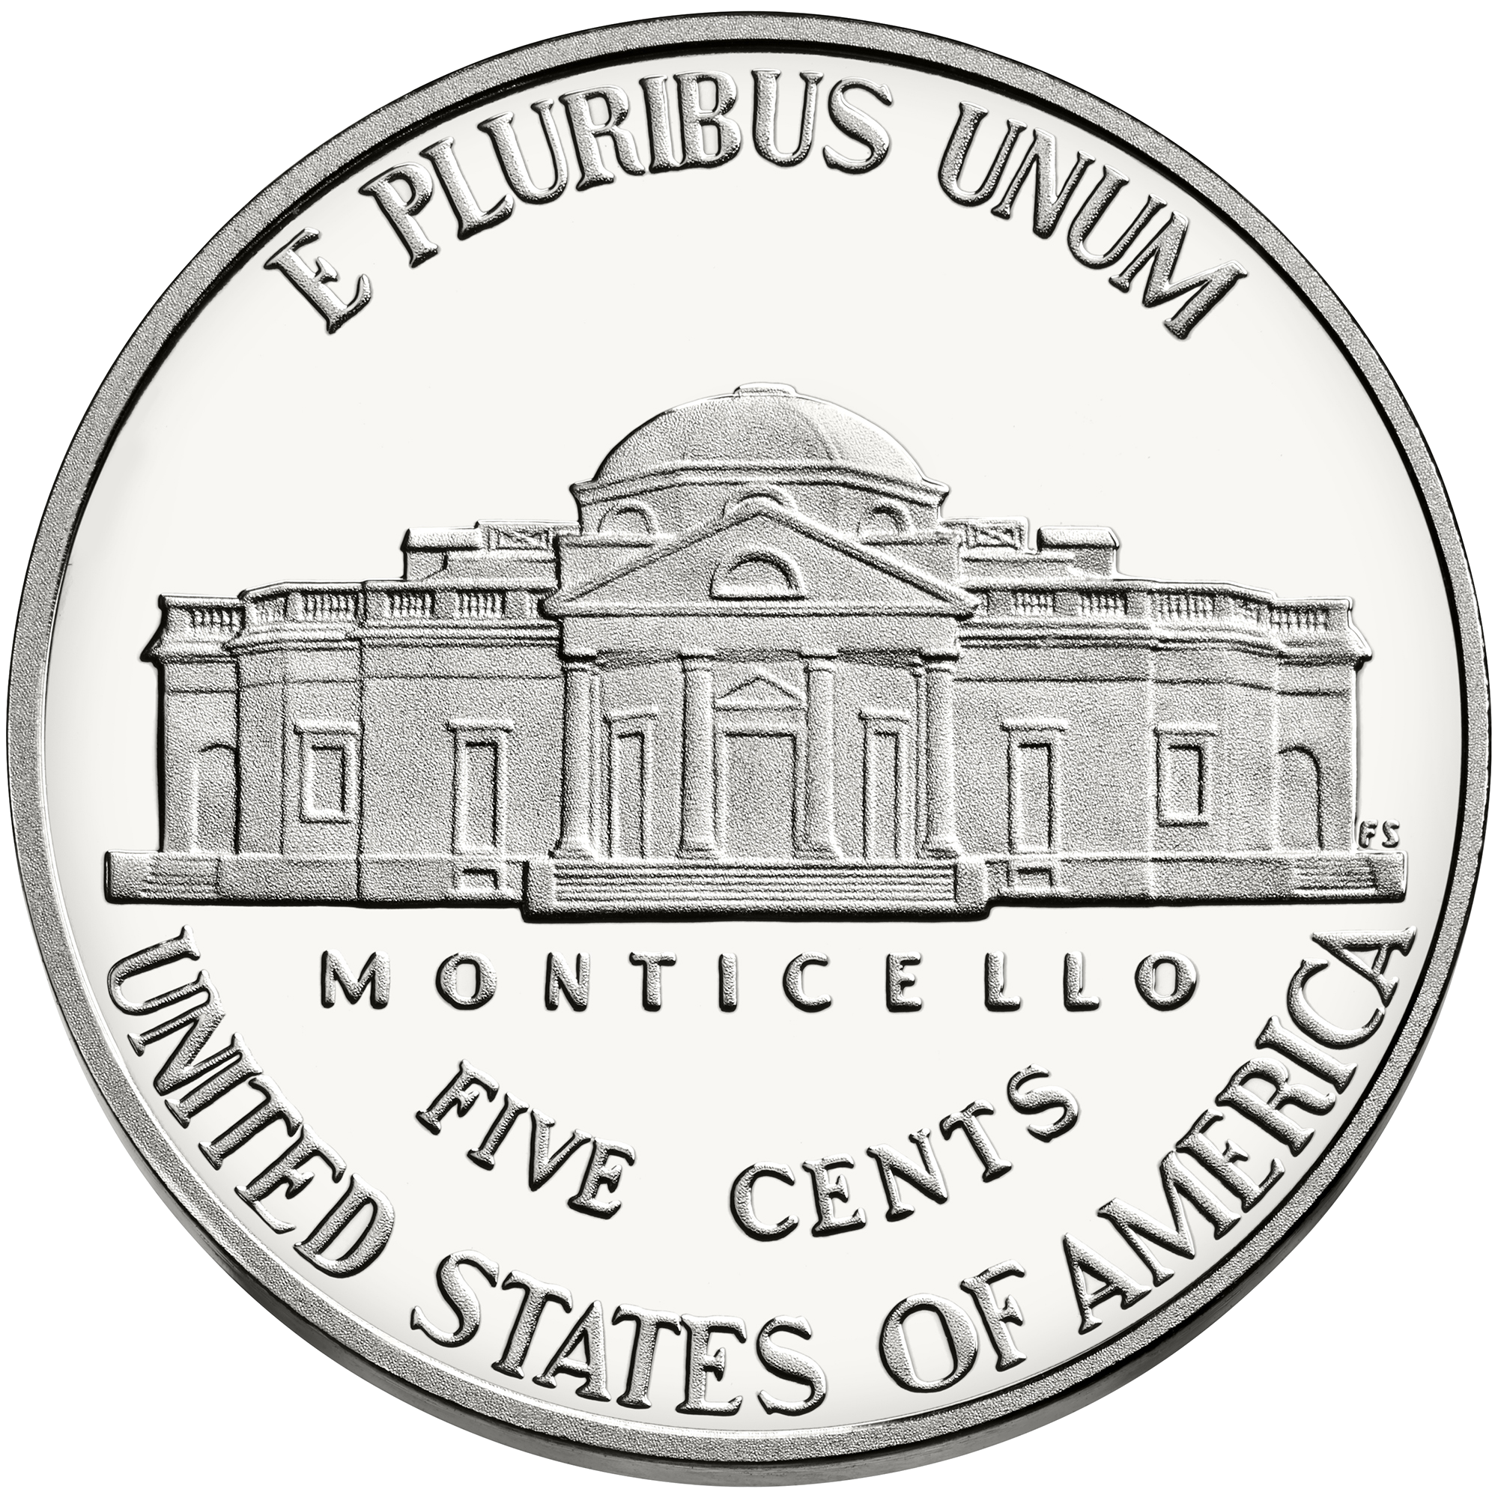
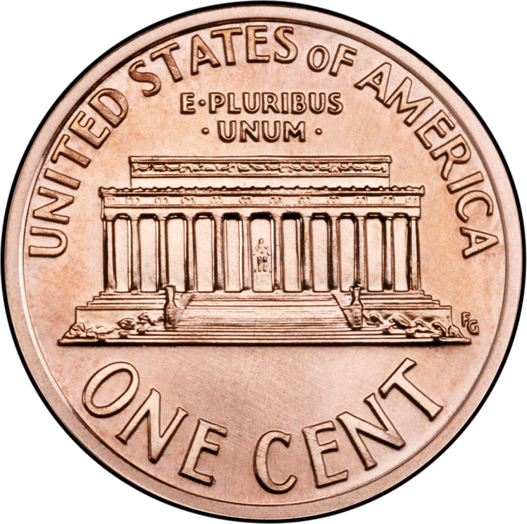
Numbers and Money
Number | Words
100…254 - 365 - 811 | A hundred/one hundred… two hundred and fifty four
1000… 3875… 15. 560 | A thousand/one thousand…three thousand eight hundred seventy five….ten thousand…fifteen thousand five hundred sixty
100.000…786,450…. 342,713…569,045 | Hundred thousand– seven hundred eighty- six thousand four hundred fifty - three hundred forty-two thousand seven hundred thirteen - five hundred sixty-nine thousand forty-five
1.000.000 | 2,450,000 – two million four hundred fifty thousand 27,805,234 - twenty-seven million eight hundred five thousands two hundred thirty-four 934,700,000 – nine hundred thirty-four million seven hundred thousand
Quarter = 25 cent
5 cents = a nickel
One cent = a penny
10 cents = a dime

Slide 24
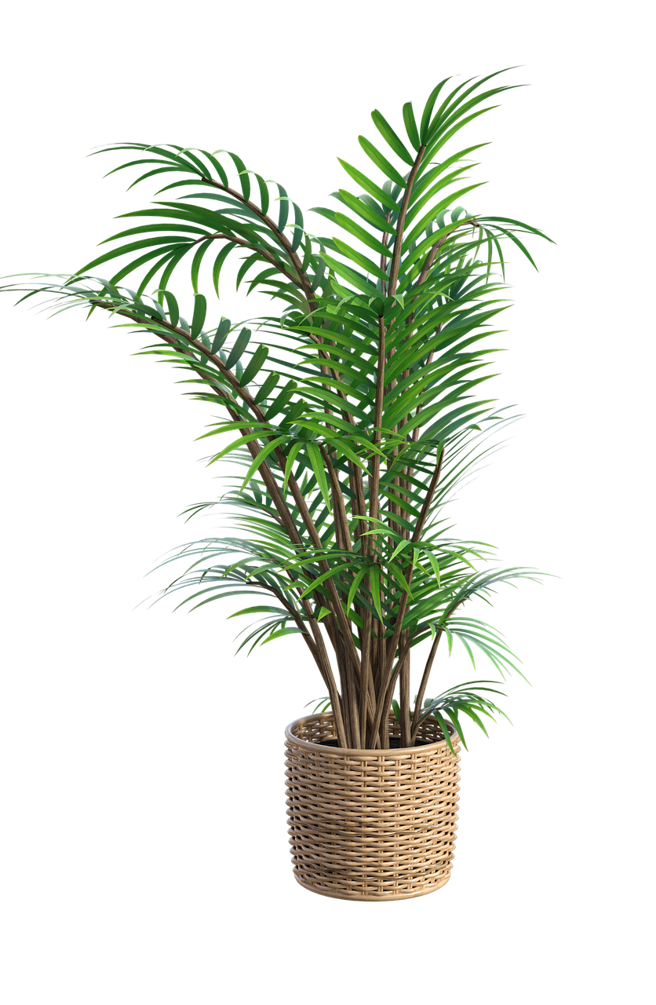

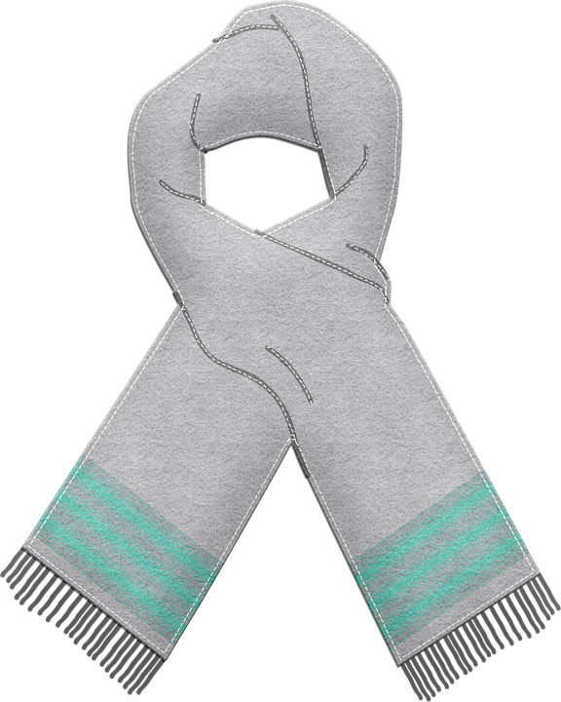

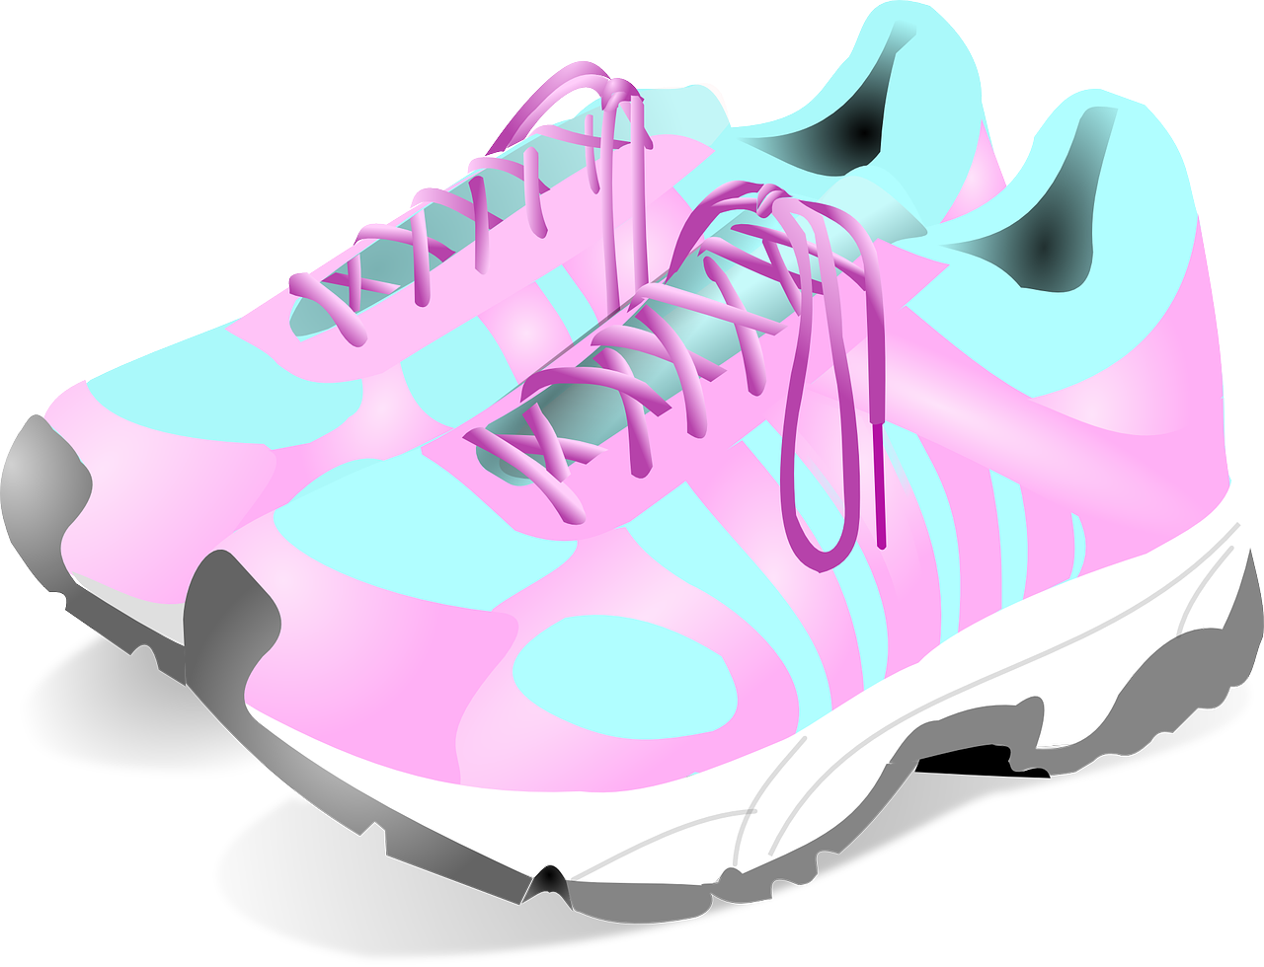


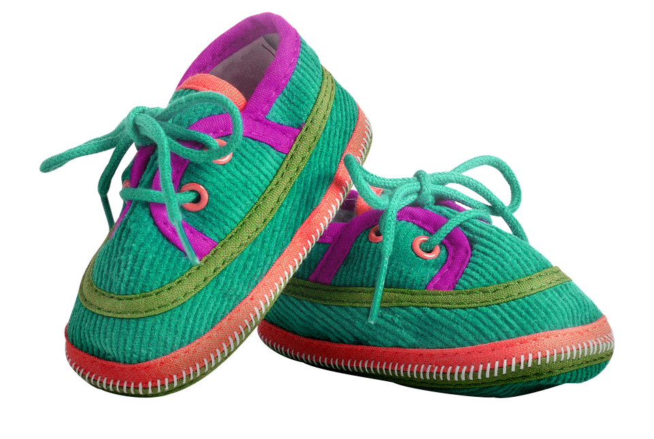
Determiners
Warm up: How many words about clothes can you write in one minute?
There
This scarf is $10.
These shoes are expensive.
Those shoes aren’t my style
That scarf is really cheap.
Here

Slide 25
End of the slides
What can an A1-level learner of English do?
They can understand and use very common everyday expressions and simple phrases for immediate needs.
They can introduce themselves and other people and can ask and answer questions about personal details, such as where they live, things they have and people they know.
They can communicate in a simple way if the other person talks slowly and clearly.

